Slide 1

Green Pace
Security Policy Presentation
Developer: Chase Carter
CS-405 Secure Coding
Notes:
Chase Carter

Slide 2

OVERVIEW: DEFENSE IN DEPTH
The policy includes coding standards testing methods encryption and risk handling
It supports defense in depth by protecting each layer from physical access to code
If one defense fails the next one can still stop the attack
We use tools like firewalls encryption patching and testing at every level
Notes:
This policy was needed because more developers are joining our team. We have been using good security practices but they were not written down in one place. Now we have a policy that makes our approach clear and easy to follow. It supports the defense in depth idea which means we use many layers of security. If one fails another one is ready.

Slide 3
THREATS MATRIX
Likely Unsafe string handling (buffer overflows) SQL injection Loop bounds errors | Priority SQL injection Unsafe string functions Improper locking or memory leaks
Low Priority Assertion usage Pointer initialization (if properly managed) | Unlikely Division by zero (if inputs are checked) Use of incorrect data types in modern compilers
Rule | Severity | Likelihood | Remediation Cost | Priority | Level
STD-001-CPP | High | Unlikely | Medium | High | 2
STD-002-CPP | High | Possible | Low | High | 4
STD-003-CPP | High | Likely | Medium | High | 5
STD-004-CPP | High | Likely | Medium | High | 5
STD-005-CPP | Medium | Possible | Medium | Medium | 3
STD-006-CPP | Low | Unlikely | Low | Low | 1
STD-007-CPP | Medium | Possible | Medium | Medium | 3
STD-008-CPP | Medium | Possible | Low | Medium | 2
STD-009-CPP | High | Likely | Low | High | 4
STD-010-CPP | High | Likely | Medium | High | 4
Notes:
This table shows the ten main risks in our code. It ranks how serious they are how likely they are to happen how hard they are to fix and the overall priority. We use tools like Cppcheck and SonarQube to scan for problems. These tools are part of our automated process. They help us find issues early before code is shared or deployed.

Slide 4
Ten Core Security Principles
1. Validate Input Data | Input from users and the other sources should never be relied on. Checking the data makes sure that it is in the correct outputs. This prevents risk from the inputs.
2. Heed Compiler Warnings | Compiler warnings show weaknesses. Fixing all the warnings improves the safety and correctness.
3. Architect and Design for Security Policies | Security should be planned and designed from the beginning of the development process. This makes sure that the system limits risk.
4. Keep It Simple | Complex systems can make hidden weaknesses. Simple, well-documented code is easier to manage and maintain securely.
5. Default Deny | Systems should stop all access by default and only allow explicitly permitted actions. This limits potential problems from a foreseen issue.
6. Adhere to the Principle of Least Privilege | Every module, process, or user should use the minimum privileges necessary. This reduces the impact of exploits.
7. Sanitize Data Sent to Other Systems | Outgoing data should be verified so that injection attacks or information leakage can be left at a minimum to the systems.
8. Practice Defense in Depth | Layered security measures help make sure that failure in one area does not compromise the entire system.
9. Use Effective Quality Assurance Techniques | Using unit testing, static analysis, peer reviews, and automated tools improves reliability and helps catch security issues early.
10. Adopt a Secure Coding Standard | Using a recognized standard like SEI CERT C++ ensures consistent, safe practices across the development team, reducing the chance of vulnerabilities.
Notes:
Our policy follows ten core principles. They include things like validating input keeping code simple denying access by default and using secure standards. Each coding rule connects to one or more of these principles. For example our first rule says to use the right data types. This matches with the principle of keeping code simple and limiting access.

Slide 5
CODING STANDARDS
1. Data Type | STD-001-CPP | Using the right data types makes sure that the memory is used efficiently and prevents overflow/underflow vulnerabilities.
2. Data Value | STD-002-CPP | Checking the data to make sure that operations are performed on safe and expected values, lowering risks.
3. String Correctness | STD-003-CPP | Wrong string handling makes the buffer overflows. Safe functions should be used instead.
4. SQL Injection | STD-004-CPP | Stops SQL injection protects against unauthorized access to databases.
5. Memory Protection | STD-005-CPP | Good memory management stops leaks and problems like buffer overflows or use-after-free.
6. Assertions | STD-006-CPP | Assertions catch logic errors in development and help document problems.
7. Exceptions | STD-007-CPP | Exception safety makes sure errors are handled and prevents program crashes.
8. Pointer Initialization | STD-008-CPP | Starting the pointers can make the code not act accordingly. Always start pointers before use.
9. Lock Management | STD-009-CPP | Not releasing locks can cause deadlocks or to stop all resources.
10. Loop Bounds | STD-010-CPP | Wrong loop code can lead to buffer overflows or infinite loops.
Notes:
We use ten coding standards. I listed them in order from most important to least based on risk and how often they happen. For example unsafe string handling and SQL injection are ranked high. That is because they are both common and dangerous. At the bottom is assertion use because it is low risk and unlikely to fail in a serious way.

Slide 6
ENCRYPTION POLICIES
Rest | All sensitive data stored in databases or file systems. All must be encrypted using AES-256 to protect data.
Flight | All network communications with information must use TLS 1.2 or higher to defend against attacks.
Use | For highly sensitive processing use hardware-backed memory encryption like intel SGX to guard against memory-scraping.
5-2 Activity Encryption Coding (XOR File Encryption)
We tested encryption and decryption using a custom XOR cipher in C++. Though not secure for production, it shows the principles of reversible encryption. Our official policy uses AES-256 for data at rest and TLS 1.2+ for data in transit.
Notes:
We protect data in three ways. At rest we encrypt all stored data using AES 256. In flight we use TLS 1.2 or better for all network traffic. In use we use hardware-based memory encryption for very sensitive data. These policies keep data safe no matter where it is.

Slide 7
TRIPLE-A POLICIES
Authentication | Require multi-factor authentication for all user and service logins. Verify and identity before giving any access.
Authorization | Role-based access control (RBAC) and least privilege. Make sure users and services can only perform explicitly approved actions.
Accounting | Allow and retain audit logs of user logins, database changes, new user additions, access levels, and file accesses. Ship logs to a SIEM for analysis.
Notes:
Triple A stands for authentication authorization and accounting. We use multi-factor authentication for logins. For authorization we use roles and give the least access needed. For accounting we log everything like logins file access and database changes. These logs go to a SIEM for review.

Slide 8
Unit Testing
Test 1: Loop Bounds Check
What happens when you access out-of-bounds indexes? A test named AtThrowsOutOfRangeOnInvalidIndex catches this. It throws an exception when trying to access vector[100] in a small vector.
Test 2: Defensive Exception Handling
Can we catch bad access on an empty container? The AtThrowsOnEmptyVector test helps confirm that the program handles empty access cleanly without crashing.
Test 3: Pointer or Resize Logic
Do resize operations keep integrity? Tests like MaxSizeAtLeastSize show that
after resizing, the container behaves as expected and no data corruption
or invalid memory access.
Notes:
Unit test one checks for division by zero. One case fails because of a zero divisor. The other case passes with a normal value.

Slide 9
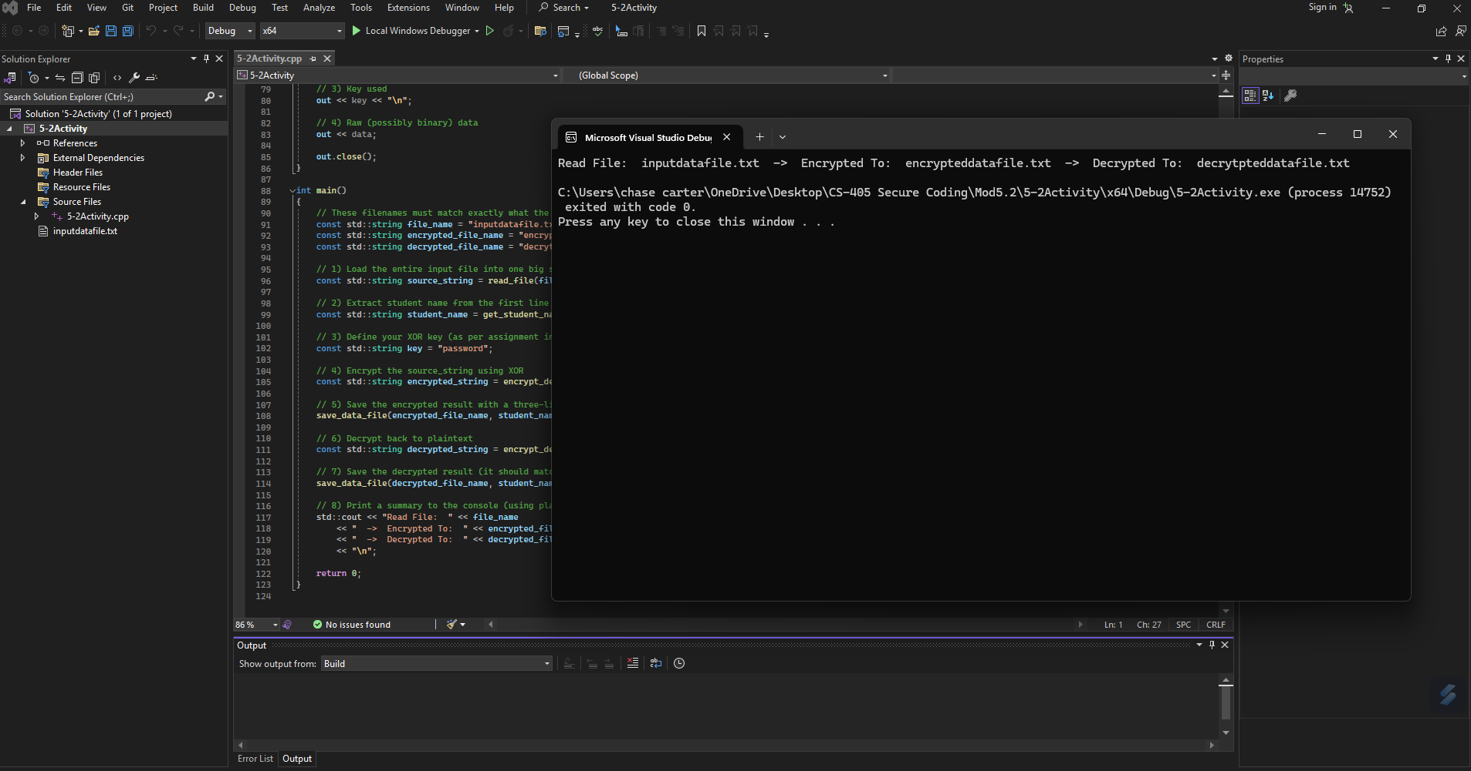

Slide 10

AUTOMATION SUMMARY
Notes:
Unit test two checks for pointer initialization. One case fails due to an uninitialized pointer. The other passes after setting the pointer.

Slide 11
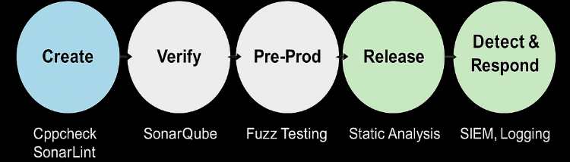
TOOLS
DevSecOps Pipeline
The main external tools are Cppchek and SonarSource. Cppcheck and SonarLint are used in the Create phase during coding. SonarQube runs during the Verify phase on each commit. In Pre-Production, fuzz testing detects edge-case failures. At Release, code must pass a final scan. In Detect & Respond, monitoring tools analyze logs and activity in real-time.
Notes:
Unit test three checks for safe string use. One case fails because the string is too long. The other uses a safe length and passes.

Slide 12
RISKS AND BENEFITS
If we fix known risks now, we avoid potential exploits and data breaches. For example, fixing SQL injection early can prevent database leaks. The risk of waiting includes higher cost, damage to customer trust, and compliance violations. Some fixes, like enforcing memory management, are low-cost and high-impact, and should be addressed immediately.
Notes:
Cppcheck and SonarLint run while we write code. SonarQube scans changes during review. We use fuzz tests before deployment. Every build is scanned again before release. Logs and tools keep apps safe in production.

Slide 13
RECOMMENDATIONS
Gaps include inconsistent tool usage and incomplete adoption of the policy across all teams. We recommend making tools like SonarSource and Cppcheck mandatory in all developer environments. Future work should include expanding test coverage, requiring compliance scans before code merges, and regular training on secure coding. We can close gaps by being proactive, not reactive, this is the key to maintaining secure systems at Green Pace.
Notes:
Fixing issues early saves time and lowers damage. Some fixes like SQL injection take more effort but block big risks. Doing nothing allows issues to grow.

Slide 14
CONCLUSIONS
To prevent future vulnerabilities, Green Pace should use SEI CERT C++ standard across all teams. All development tools should make the rules automatically. Regular code reviews, static analysis, and training sessions will support long-term compliance. Staying updated with best practices and using automation will help us build secure, scalable software as our organization grows.
Notes:
Not all tools are in use yet. Some code still breaks policy. We must train the team and make tools required. Improving now prevents bigger problems later.

Slide 15
REFERENCES
cplusplus.com. (n.d.). Encrypt and decrypt a file using XOR. C++ Forum. Retrieved June 20, 2025, from https://cplusplus.com/forum/windows/128374/
Programming Algorithms. (n.d.). XOR encryption. Retrieved June 20, 2025, from https://www.programmingalgorithms.com/algorithm/xor-encryption/cpp/
TechBeacon. (2024, January 17). 6 DevSecOps best practices: Automate early and often. Archived from the original at https://techbeacon.com. https://web.archive.org/web/20240117143629/https://techbeacon.com/security/6-devsecops-best-practices-automate-early-often
SonarSource. (n.d.). Clean code for C++ developers with SonarQube. SonarQube Documentation. Retrieved June 20, 2025, from https://docs.sonarsource.com/cpp/
Cppcheck. (n.d.). Cppcheck: A tool for static C/C++ code analysis. Retrieved June 20, 2025, from https://cppcheck.sourceforge.io/
Notes:
We should follow secure coding standards and always update our tools. Working together and keeping security a focus will help Green Pace stay safe.

